Slide 1
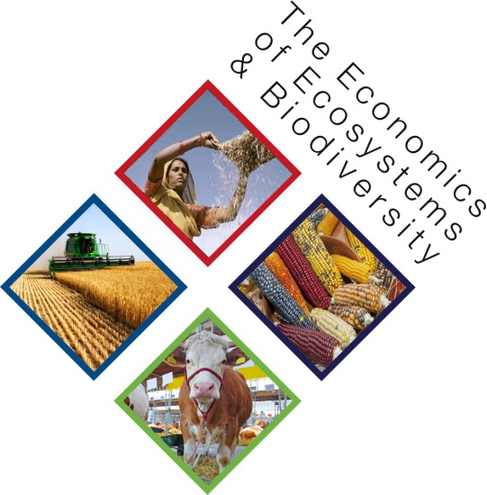
TEEB for Agriculture and Food:
Expert workshop on SDGs/chemicals & waste Geneva, April 2016
Dr. Salman Hussain
UNEP TEEB Office

Slide 2
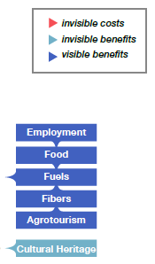
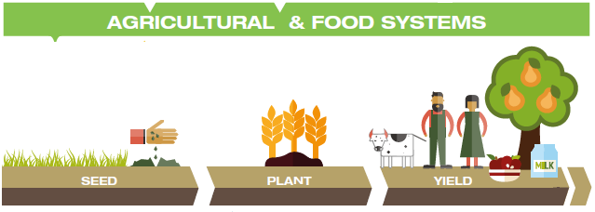
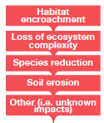
The ‘eco-agri-food’ system complex
Notes:
The schema presents the study´s framework, outlining the processes and relationships that characterize eco-agri-food systems. An important element of this framework are the positive and negative externalities which will be consider to be ‘material’ to the discussion. While this schematic forms the basis for the structure of the TEEBAgFood study overall, it is more specifically intended for TEEBAF Foundations and its structure/wireframe.
Ecosystems and agricultural & food systems are typically evaluated in isolation from one another, despite their many and significant links. However, ecosystems are the ecological home in which crop and livestock systems thrive and produce food for humans, and in turn agricultural practices, food production, distribution and consumption impose several unquantified externalities on ecosystem health.
The draft wireframe for the Foundations report is based on the need to characterize the linkages between the three main components of this nexus, i.e. (i) ‘human (economic and social) systems’ (ii) ‘agriculture and food systems’, and (iii) ‘ecosystems and biodiversity’.
Science and technology provide a number of inputs to ‘agriculture and food systems’.
‘Labor’ is a factor of production but might also include more broadly ‘human capital’, i.e. human knowledge of agro-ecological processes (e.g. composting, crop livestock integration).
There are positive outputs from ‘agriculture and food systems’. Some of these are visible and generally marketed (such as ‘food’ and ‘raw materials’.) In other cases there are positive impacts that are invisible (or less visible).
There are also negative externalities from ‘agriculture and food systems’. Some affect human welfare directly, such as health impacts arising from agro-chemicals.
The final element of the schematic is the inputs provided by ‘ecosystems and biodiversity’ to ‘agriculture and food systems’. The agricultural sector is and always has been more intertwined with ecosystems (and dependent on their provisioning of services) than most other industrial sectors.

Slide 3
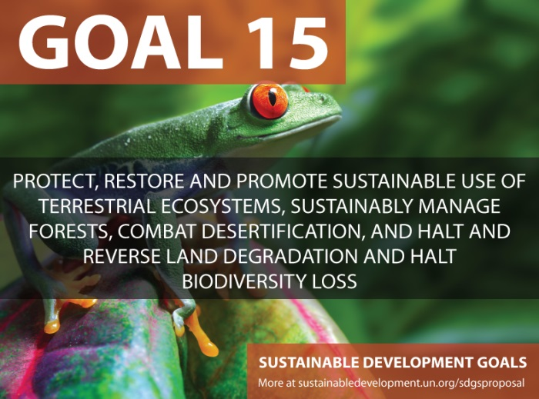
TEEBAgriFood > SDGs

Slide 4
Why is TEEBAgriFood focusing on health externalities?
Annually, the world uses about 3 million tons of pesticides
an estimated 0.1% reach the target pests
Environmental impacts can include widespread decline of birds, amphibians, and beneficial insect populations
Pesticides can also enter human bodies directly and through food chains
traces of DDT, lindane and dieldrin in fish, eggs and vegetables still exceed the safe range in India
As many as 25 million agricultural workers worldwide experience unintentional pesticide poisonings each year
teebweb.org/agriculture-and-food

Slide 5
How can TEEBAgriFood Provide Evidence at the health-ecosystem interface?
Individual sector studies to compare health impacts
Production processes versus production systems
Food chain analysis: what policies can change dietary patterns and health outcomes?
Strategic behavior: asymmetric and incomplete information and links to food labelling
Trade agreements
Behavioral economics – ‘nudging’ behavioral change versus regulatory and pricing/market interventions
The economic metric
how to value changes in health outcomes?
teebweb.org/agriculture-and-food

Slide 6
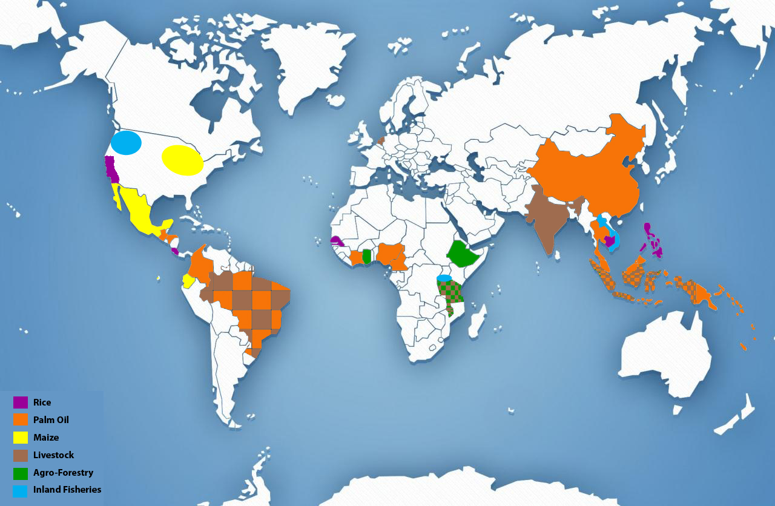
Feeder Studies

Slide 7
Increasing rice yields vs Reducing water consumption
teebweb.org/agriculture-and-food

Slide 8
Thank You!
Dr. Salman Hussain
UNEP TEEB Office
www.teebweb.org/agriculture-and-food

